Slide 1
Find Your Inner Tech Talk in 60 Minutes
Katerina Domenikou, Bloomberg | @kat_in_gloves Vedika Dalmia, Bloomberg | @vedikad

Slide 2

Aim

Slide 3
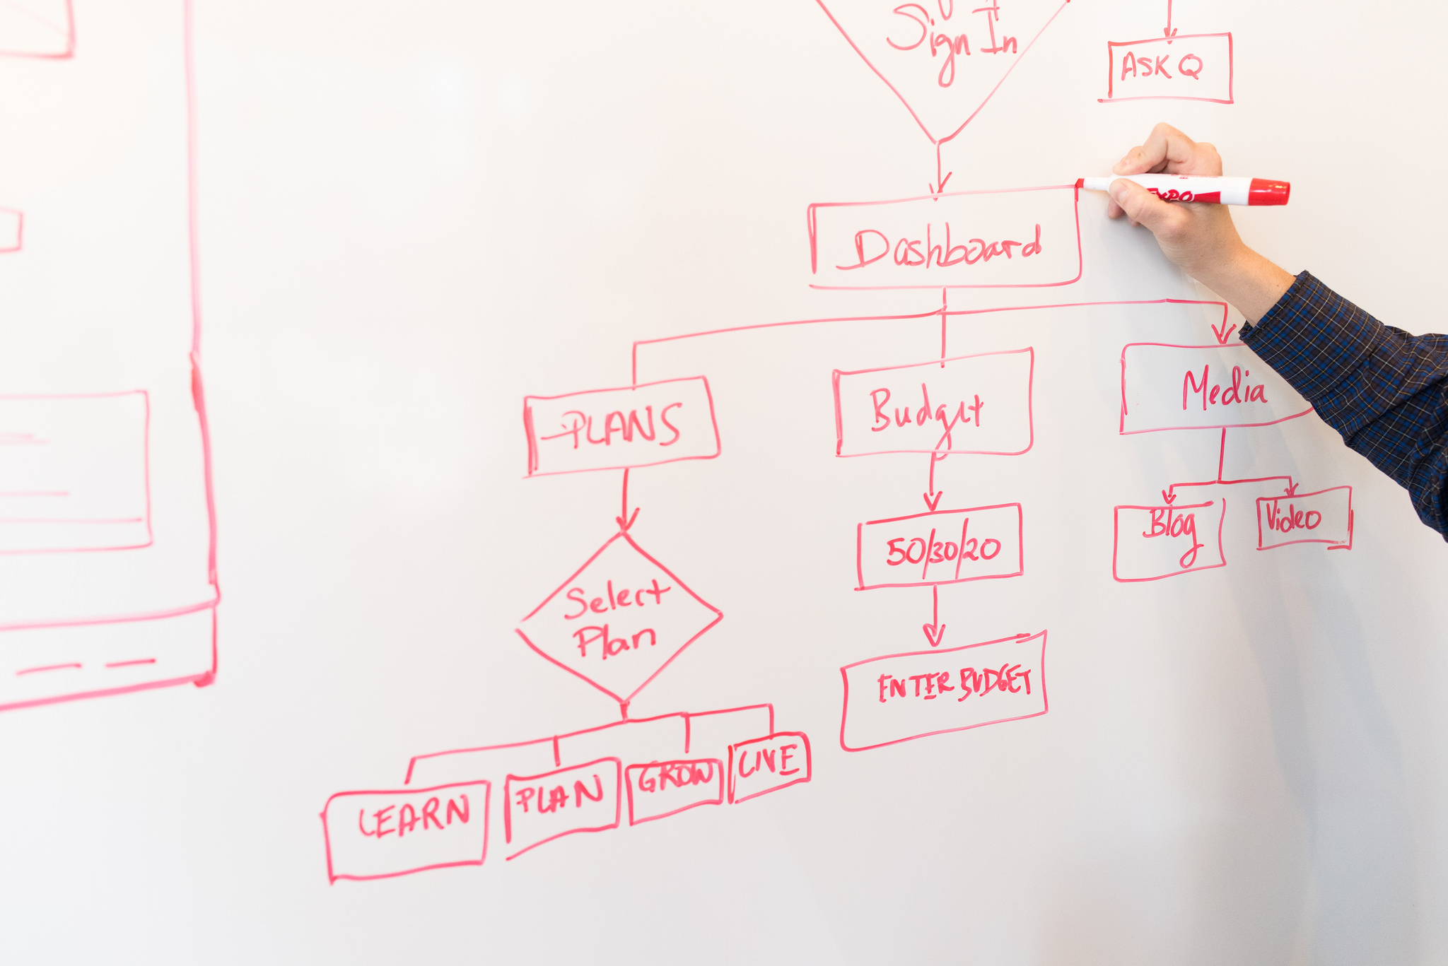
Plan
Goal Setting
Brainstorming
Refining
Planning
Commit

Slide 4

Pair up!

Slide 5
1 min left
Time’s up!

Slide 6

<Goal>

Slide 7
1 min left
Time’s up!

Slide 8
Some Goals
Improve public speaking
Recruit people
Share passion
Influence people
Share knowledge
Establish expertise
Career development
Learn/teach new tech

Slide 9
1 min left
Time’s up!

Slide 10
</Goal>

Slide 11

<Brainstorming>

Slide 12

<Card Game>

Slide 13
Rules
Answer quickly
Keep it short
Go through more

Slide 14
6 mins left
1 min left
5 mins left
4 mins left
2 mins left
7 mins left
3 mins left
Time’s up!
10 mins left
9 mins left
8 mins left

Slide 15
</Card Game>

Slide 16

<Six Boxes>

Slide 17
1 min left
5 mins left
4 mins left
2 mins left
3 mins left
Time’s up!

Slide 18
</Six Boxes>

Slide 19
</Brainstorming>

Slide 20

<Refining>

Slide 21
Tools: Graphs
Impact vs Effort
Novelty vs Effort
High Impact
Low Effort
High Impact
High Effort
High Novelty factor
Low Effort
High Novelty factor
High Effort
Low Impact
Low Effort
Low Impact
High Effort
Low Novelty factor
Low Effort
Low Novelty factor
High Effort

Slide 22

Tools: Questions

Slide 23
6 mins left
1 min left
5 mins left
4 mins left
2 mins left
7 mins left
3 mins left
Time’s up!
10 mins left
9 mins left
8 mins left

Slide 24

The One
Meets my goal
I’m passionate about
I’m willing to put effort into

Slide 25
</Refining>

Slide 26

<Planning>

Slide 27

Ideal Audience

Slide 28

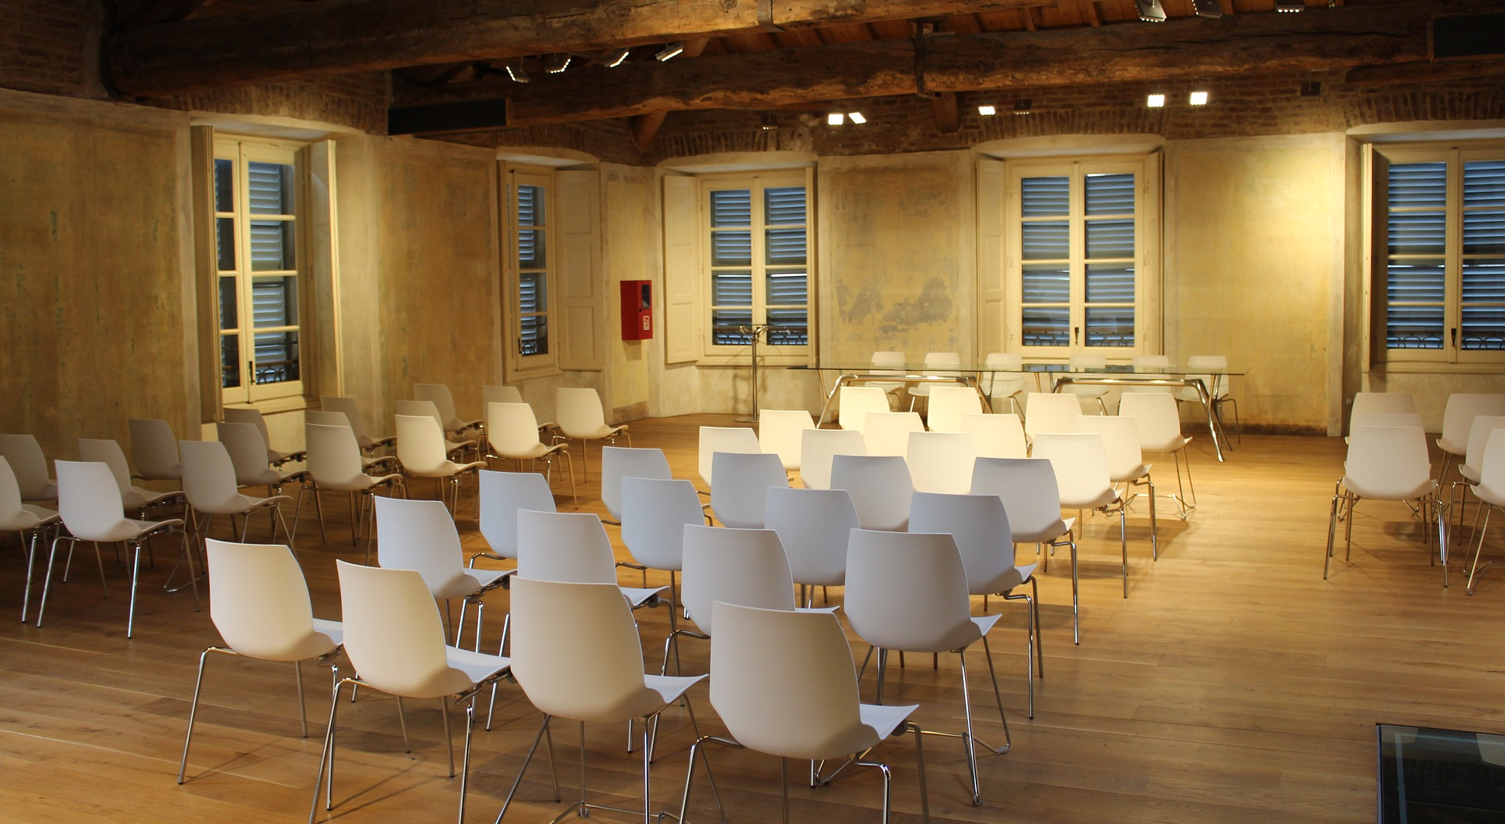
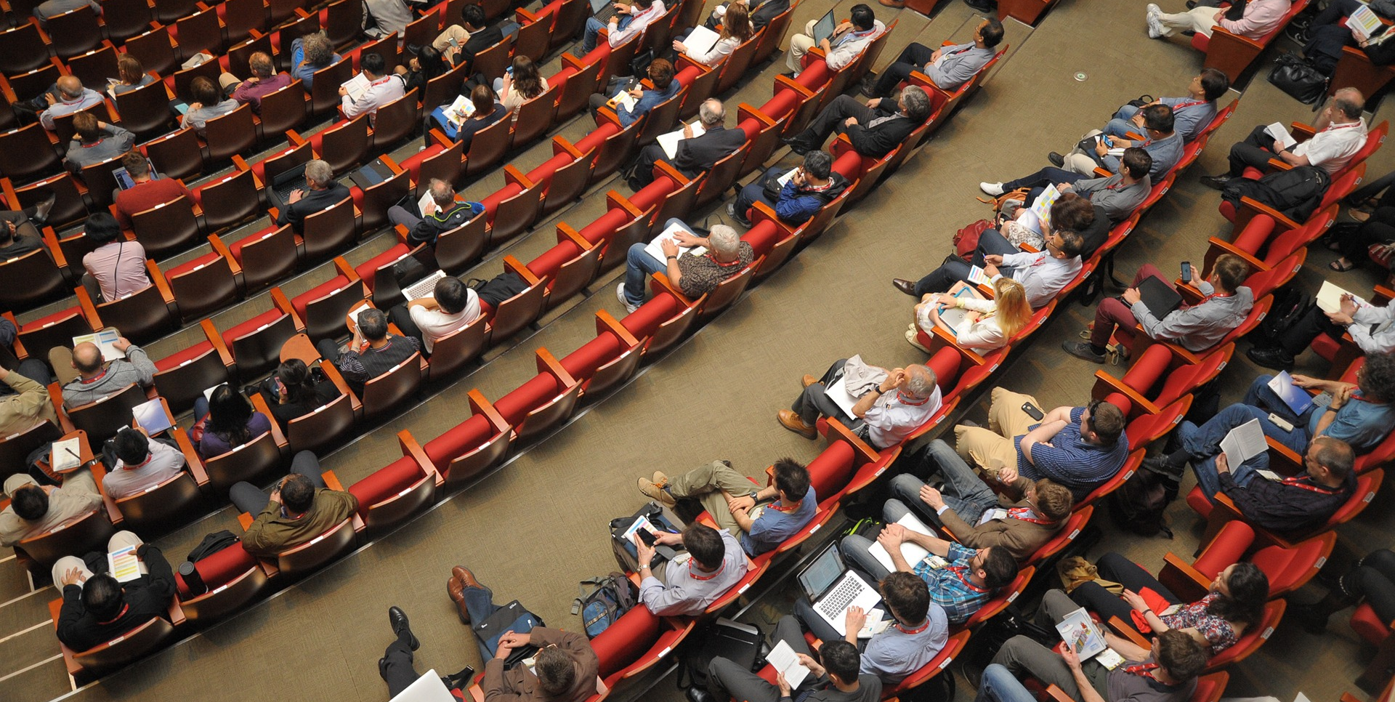
Potential Venue

Slide 29



Format

Slide 30
Title
Promise benefits
Promise a story
Use the number 3 at the front
Provoke curiosity
Evoke concern
Add contrast
Imply privileged information
Mix and match
Source: http://www.speakingaboutpresenting.com/content/presentation-title/

Slide 31
1 min left
5 mins left
4 mins left
2 mins left
3 mins left
Time’s up!

Slide 32
<Abstract/>

Slide 33
</Planning>

Slide 34
<Commit>
Tweet your topic to @mynexttalk
Share contacts with people around you
Resources/materials on github.com/bloomberg/mynexttalk

